Slide 1
STACK ADT
CPSC 131- Data Structures
Shrinivas Patil

Slide 2
Container Adapter
Container: class that implements a data structure (e.g. std::vector)
Adapter: container that
Uses a pre-existing container
To implement a new, different interface
Adapter provides a higher-level API to client code
Data structure details are abstract
Reuse: use predefined code to create new code
Reduction: use predefined algo./data structure to create new algo./structure
Key skill ~ how technology is created

Slide 3
Correspondence Between Operations
Adapter: container that
Uses a pre-existing container
To implement a new, different interface
Correspondence: each new operation corresponds to operation(s) in the preexisting structure operations
Each new concept corresponds to a concept in the container
Problem-solving challenge in creating a container adapter
Code follows directly from these correspondences

Slide 4
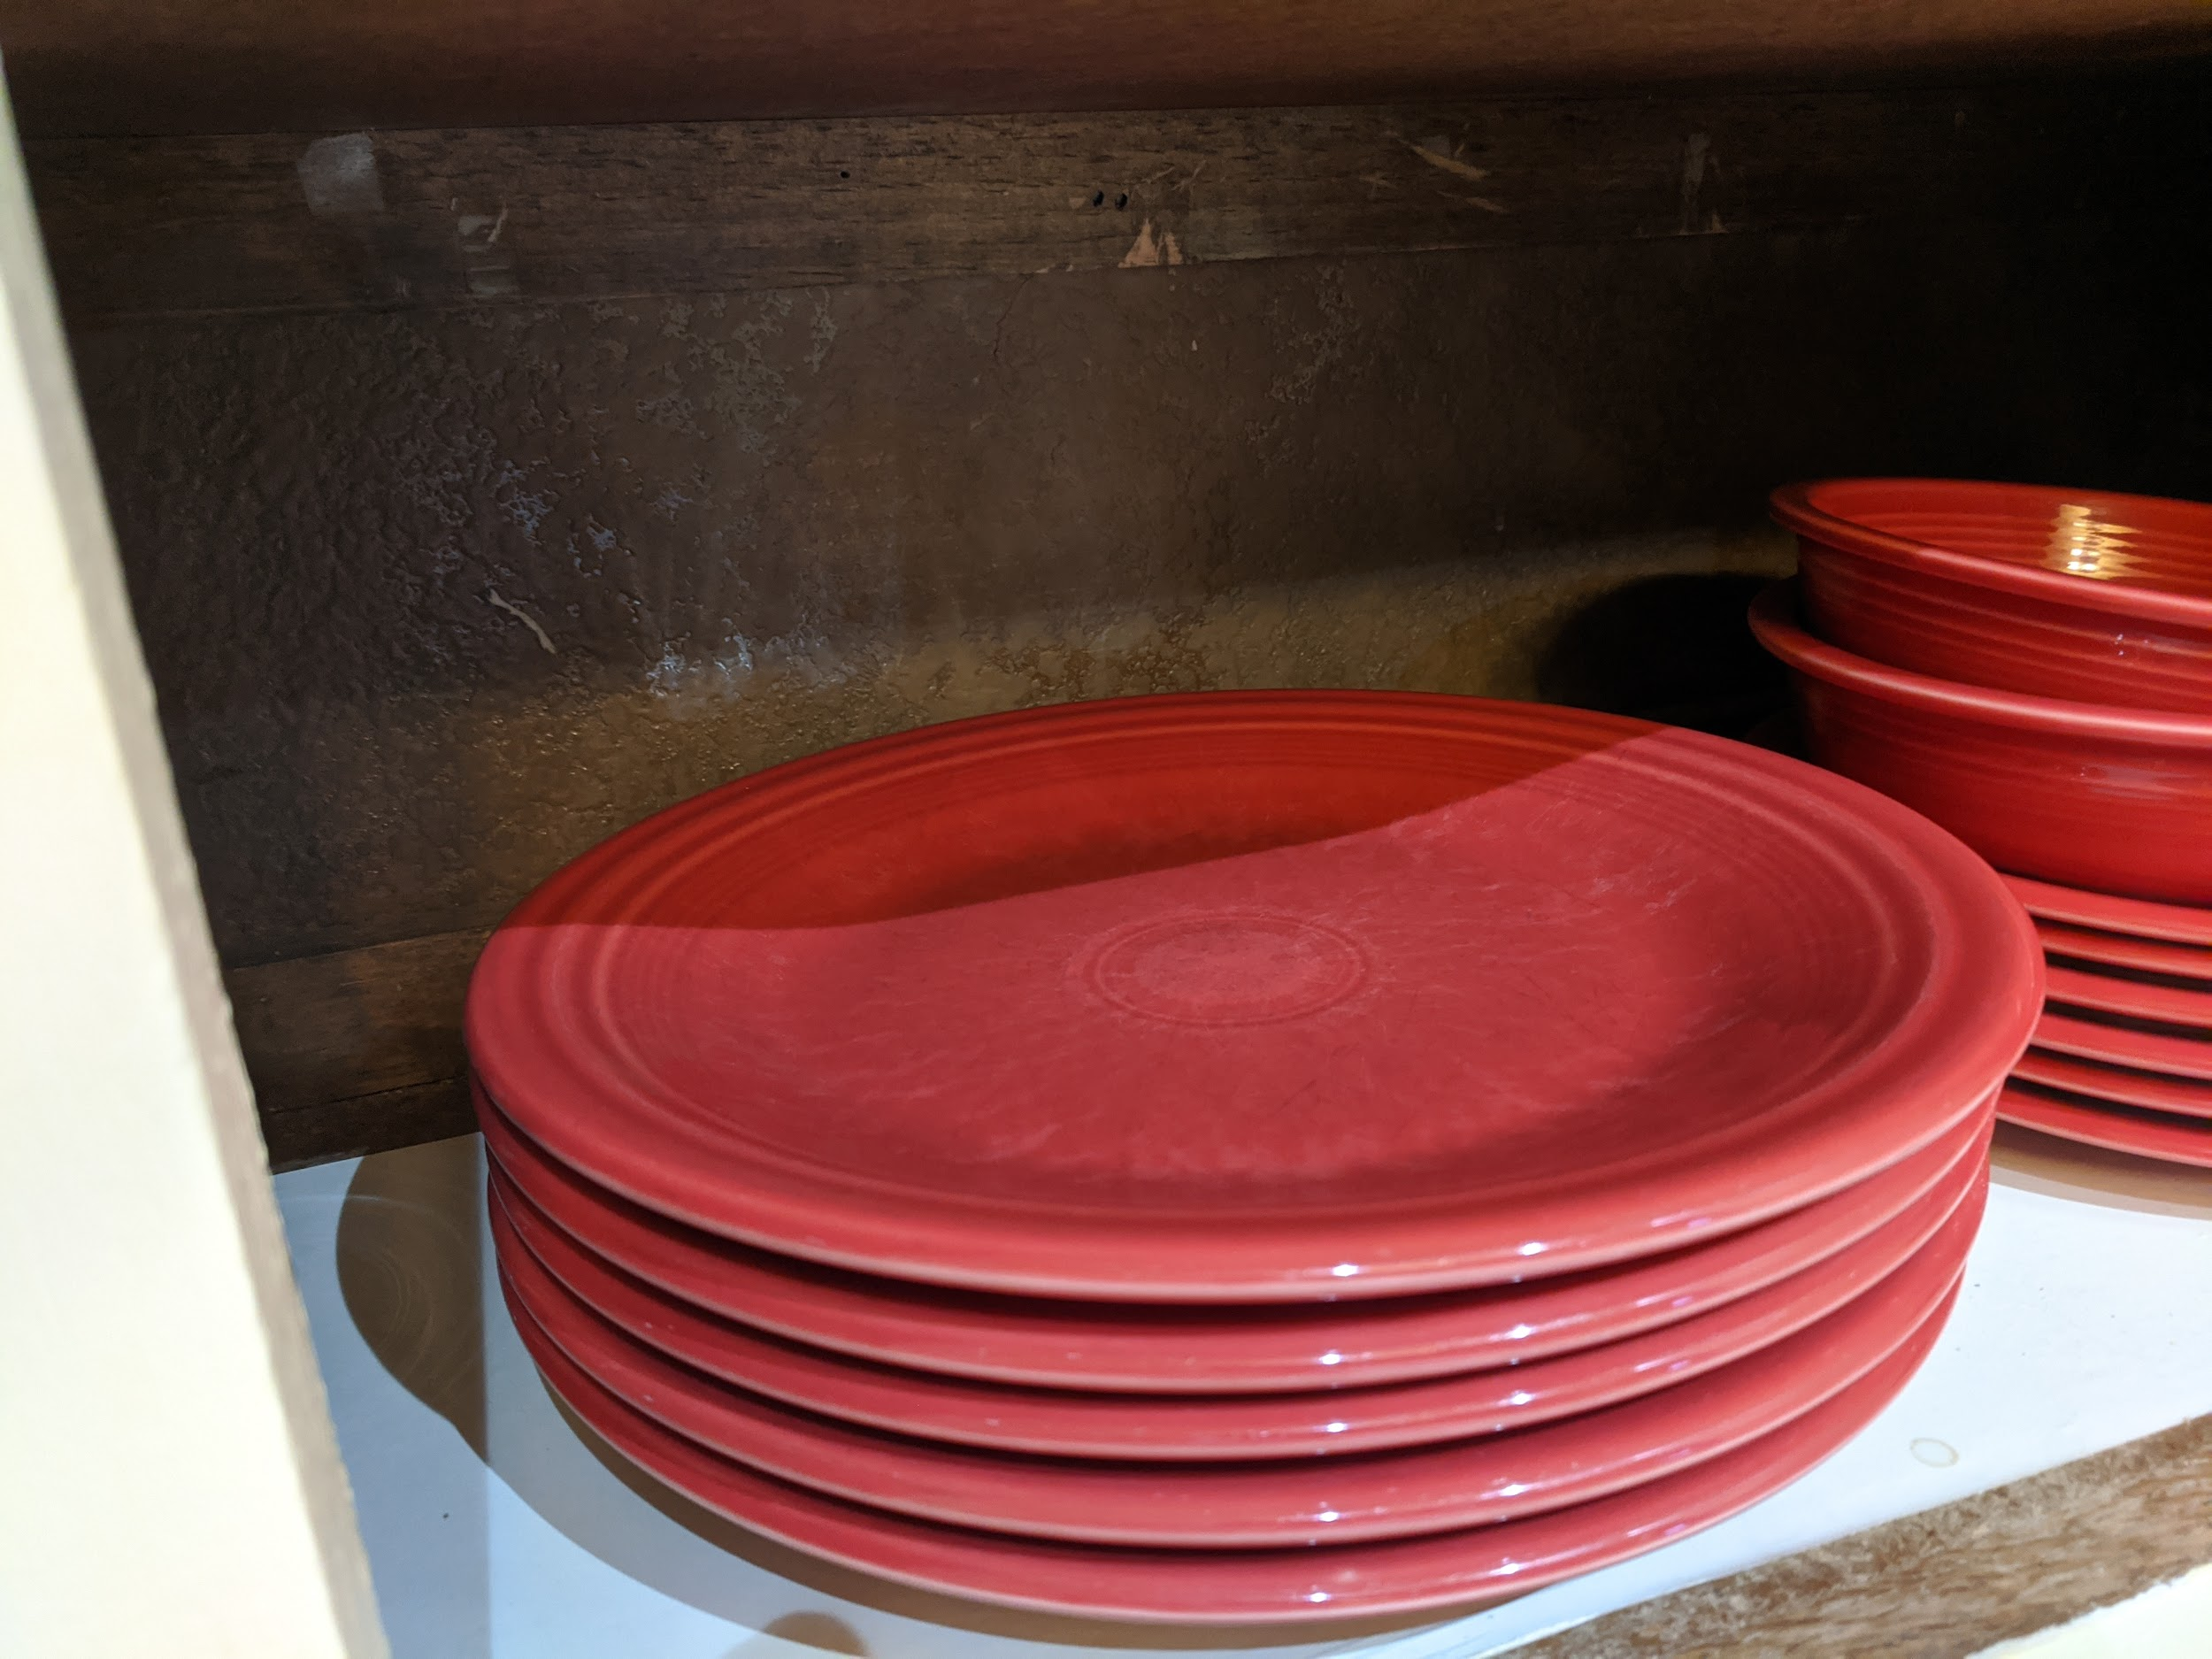
Stack Abstract Data Type
Stack: data structure that organizes elements into LIFO
LIFO: Last In, First Out
Inspiration: stack of plates
See, add, remove, plate: only convenient at the top

Slide 5
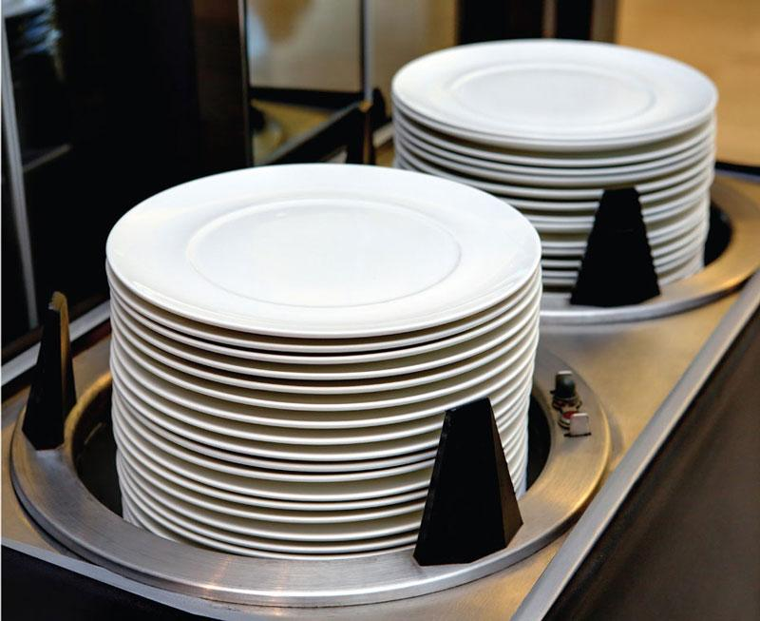
Stack Operations
Inspired by cafeteria dish dispenser
Top(): return the element which is at the top
Push(x): insert x at the top
x becomes new top
Other elements move away from the top
Pop(): remove the top element
Other elements move toward the top
Image credit: http://miseenplaceasia.com/dish-warmer-dispenser/

Slide 6
Sketching a Stack
Column of elements inside a “bucket”
Top element is at the top
Implicit
38 -1 8 31 12

Slide 7
Example Stack Operations
Create empty

Slide 8
Example Stack Operations
Create empty
Push 6
6

Slide 9
Example Stack Operations
Create empty
Push 6
Push 5
5 6

Slide 10
Example Stack Operations
Create empty
Push 6
Push 5
5 6

Slide 11
Example Stack Operations
Create empty
Push 6
Push 5
Push 7
Pop
5 6

Slide 12
Example Stack Operations
Create empty
Push 6
Push 5
Push 7
Pop
Push 1
1 5 6

Slide 13
Example Stack Operations
Create empty
Push 6
Push 5
Push 7
Pop
Push 1
Push 4
4 1 5 6

Slide 14
Example Stack Operations
Create empty
Push 6
Push 5
Push 7
Pop
Push 1
Push 4
Pop
1 5 6

Slide 15
Stack Applications
CPSC 131- Data Structures
Shrinivas Patil

Slide 16
Stack Application
Recursion functions
Used in evaluating arithmetic expressions
Infix notations
Prefix notations
Postfix notations
Delimiter checking (ex. valid parenthesis)
Reverse the elements
Browser back Button
Undo/redo functions in text editor
Depth first search

Slide 17
Recursion calls
Whenever recursion call is performed it will be pushed in stack
Same step will be performed until recursion condition is false
Once condition become true it will return value and return to previous function call
The executed function call popped out from stack
The same steps followed until stack is not empty
Ex: recursion program for factorial fact(n)

Slide 18
Application: Function Calls
Assembly programming topic
Runtime has control stack to jump to, from function calls
Original reason for “the stack”
Call function:
Push(instruction pointer)
Jump to function body
Return:
Pop()
Jump to Top()
Hardware support (CPU instructions)
double L1Distance(double x1, double y1, double x2, double y2) { double dx = abs(x1 - x2); double dy = abs(y1 - y2); return dx + dy; } double abs(double value) { if (value < 0.0) { return -value; } else { return value; }

Slide 19
Application: Browser Back Button
Back button follows LIFO
Press back: go to most-recent web page
Back again: go to the one just before that
History is a stack
Visit page: Push(URL)
Go back:
Pop() current page
Go to Top()

Slide 20
Application: Undo
Undo ⎌ follows LIFO
Undo: restore most-recent document version
Undo again: restore document version just before that
Edit history is a stack
Make an edit (e.g. typing): Push(changes made)
Undo:
Top() gives most-recent changes
Reverse them
Pop()

Slide 21
Application: Depth-First Search (DFS)
Algorithm for traversing a graph
Advanced data structures, or algorithms, topic
Uses stack as TODO list of unexplored vertices
Animation credit: https://commons.wikimedia.org/wiki/File:Depth-First-Search.gif , CC-BY-SA

Slide 22
Reverse Elements
Given string or container reverse the elements of string
Ex 1) S=”string” reverse the string.
Traverse each character and push each character in stack
Stack = [‘s’,’t’,’r’,’i’,’n’,’g’]
Once you push all character start popping out each character
Stack = [‘s’,’t’,’r’,’i’,’n’] output = ‘g’
Stack = [‘s’,’t’,’r’,’i’] output = ‘gn’
Stack = [‘s’,’t’,’r’] output = ‘gni’
Stack = [‘s’,’t’] output = ‘gnir’
Stack = [‘s’] output = ‘gnirt’
Stack = [] output = ‘gnirts’

